Slide 1
Superstore Sales Dataset For Analysis Using Power BI

Slide 2
Introduction and Data Background
This superstore data set encompass retail businesses of various sizes, ranging from small to large, offering a diverse range of items at competitive prices to both local and global customers. It is essential for store owners to consistently monitor the Key Performance Indicators (KPIs) of their establishments to ensure they can make well-informed business decisions.
The global superstore sales dataset used for this project is publicly available on Kaggle. The data comprises sales data for three product categories: Furniture, Office Supplies, and Technology, which are sold to three types of customers (Consumer, Corporate, and Home Office) across various geographical locations.

Slide 3
Process
I am excited to state that, I took the necessary process in ensuring that this project has passed through the necessary steps and procedure before finally arriving at the final result.
Two common data cleaning tasks are performed on the dataset. The first involves identifying NULL or missing values, while the second entails checking for any duplicated records. Power BI and Excel, both offers built-in features for both of these tasks.

Slide 4
Objectives
There are two main tasks identified when carrying out this project
Task 1: Efficiently clean, transform, and analyze the dataset
Task 2: Uncover valuable and unexpected hidden insights from the data, answering business questions and providing strategic recommendations

Slide 5
Business Questions/ KPIs
Which segment is the bestseller?
What are the Highest selling and Lowest Selling Sub-Category?
How much each sub-category contributes to the sales of superstore?
Who are the Top 10 Customers of the Superstore?
What are the Top 10 States with highest number of orders (highest order count)?

Slide 6
Business Questions/ KPIs
Which region has the highest order count and in which region do we need to grow our Business? (alternative Q: Which region has the highest sales, and which one has the lowest over the year 2011–2014?)
Growth of Superstore sales over the year 2011–2014
What are the top 10 most selling Products?
What is the most preferred Ship Mode?

Slide 7
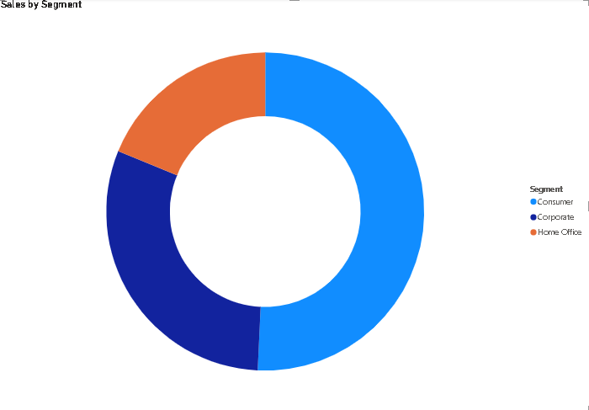
Sales by Segment
Looking at this donut chat it is simply showing that among the three segments, the one making the most sales is consumer segment with total sales amounting to 50.76% of our entire revenue.
This is followed by corporate segment contributing 30.44% to the entire revenue and Home Service segment also contributing a significant 18.79% to the entire total revenue.
This shows that the consumer segment is having something good going on and that more focus should be given in order to make more sales in that particular segment.
Also, focus should be given to Home service segment if management would like to gain more revenue from that segment.

Slide 8
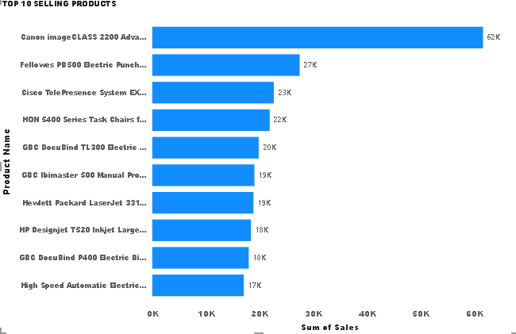
Top 5 Selling Sub-Category
The stacked column chart highlights the top 5 selling sub-category products management should focus on to make the most revenue from. Especially the top 2 products being phones and chairs. Clearly there isn’t significant difference in sales between these two sub-category products especially. So, even though the remaining 3 sub-category products are doing amazing a keen eye must be on these two.

Slide 9
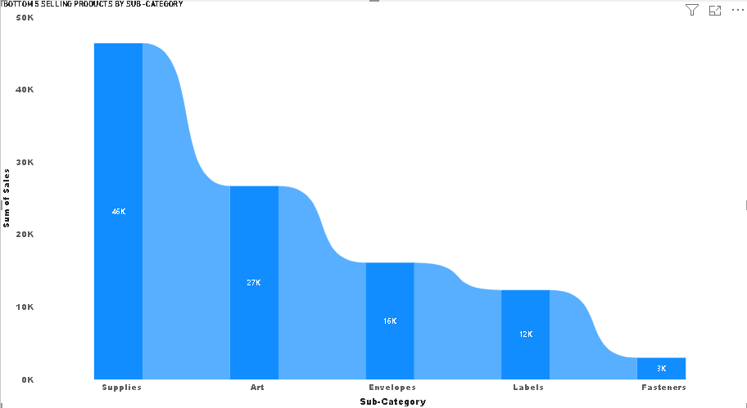
Bottom 5 Selling Products by Sub-Category
From the ribbon chart, we can tell the 5 bottom selling products by sub-category with fasteners being the sub-category providing the least sales altogether, with labels following closing behind along with envelopes.
This shows that management should come up with measures and policies to drive real sales and revenue from these sub-categories if it’s something they are interested in or shut these sub-category products down and focus more on the top selling sub-category products.

Slide 10
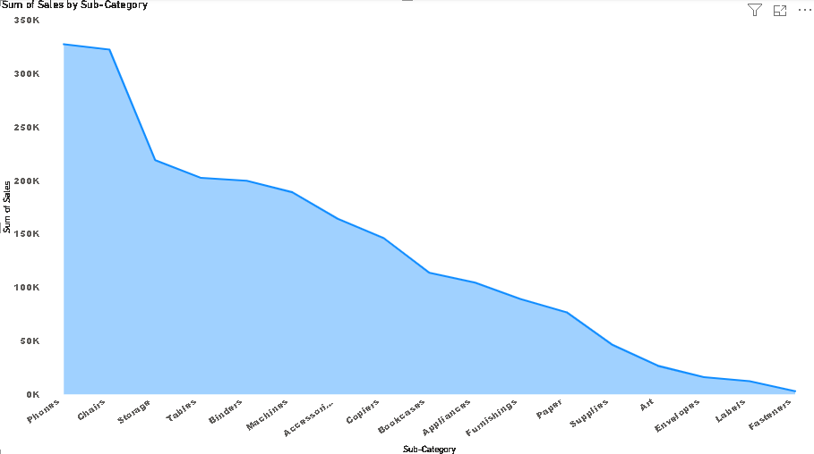
How much each sub-category contributes to superstore
The area chart shows which sub-category is contributing more to superstore and which is contributing less.
As seen, the highest sub-category contributing to superstore is Phones, contributing a total of 327,782.45 USD to superstore whiles, the lowest sub-category been fasteners contributes a total of 3001.96 to superstore.

Slide 11
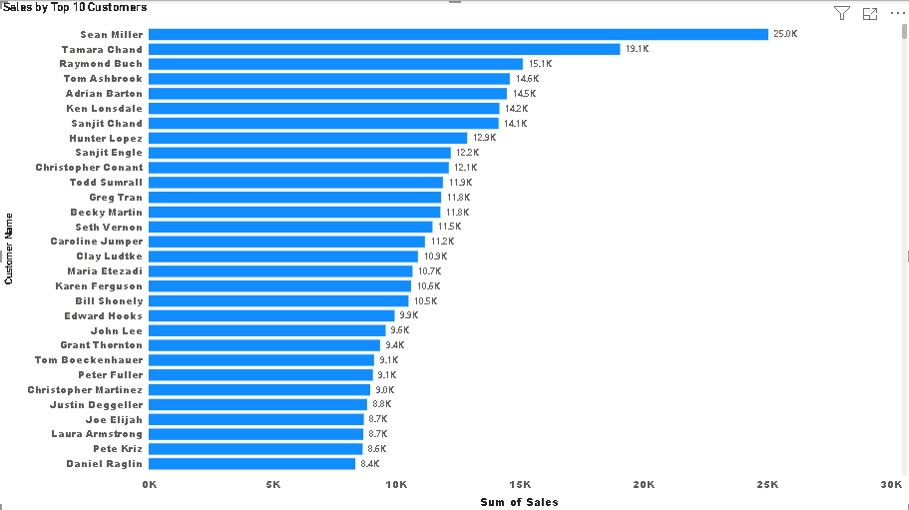
Top 10 customers
Well, looking at this chart, we can see that there really is no significant difference between the top 10 customers in terms of how much revenue that is generated from them.
As a result, the company should try and strengthen their relationship with all of them in order to win their loyalty and retention. This will help the company increase revenue even more.

Slide 12
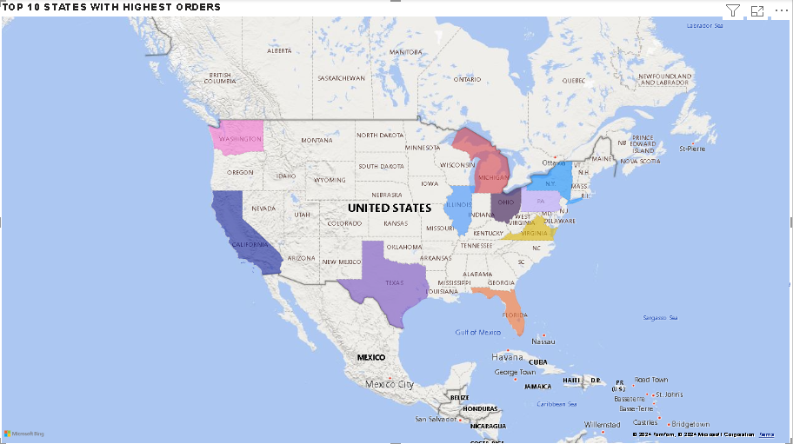
Top 10 States with Highest Orders
This map chart shows that the majority of Orders revenue is generated from Texas, then California followed by Washington and Michigan and so forth.
The map chart also shows which states have higher order counts even amongst the top 10 states that management can use in their decision making.

Slide 13
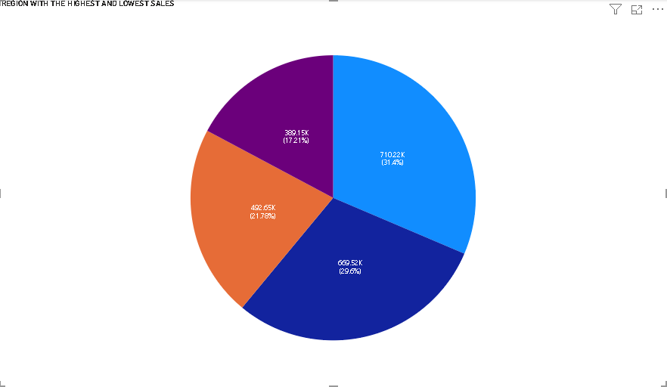
Which Region has the Highest and Lowest Sales
The pie chart shows the various regions and also their sales contributions towards the Superstore.
From the chat, we can deduce the following;
The western region currently contributes the greatest proportion to superstore at an amount of 710,219.68 USD representing 31.4% followed by East which also contributes a total of 669,518.73 USD representing 29.6%, followed by Central contributing a total of 492646.91 USD representing 21.78% and the lowest contributing region being South contributing a total of 389151.45 USD representing 17.21% of the total sales to superstore.

Slide 14
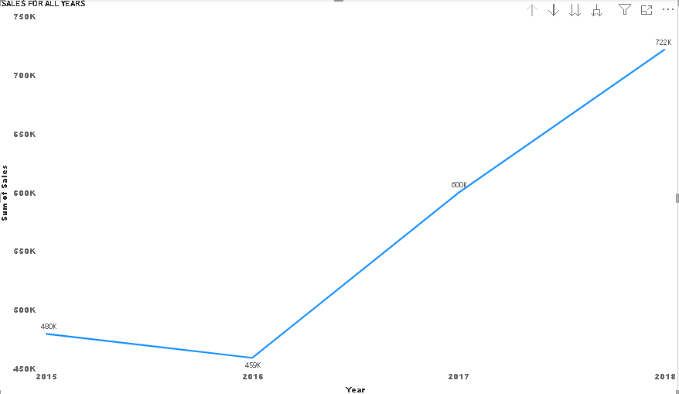
Growth of Superstore sales over the year 2015–2018
This shows that for the first 2 years, total sales or revenue was rather stable with an average revenue of 469,646.11 USD
However, we can see a steady rise in revenue from the third and fourth year.

Slide 15
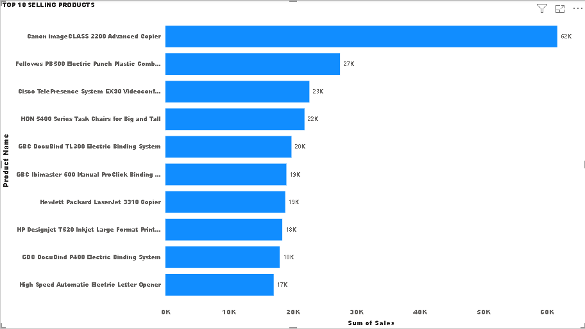
Top 10 Selling Products
This bar chart shows the top 10 selling products for superstore with Canon image glass topping the list with a significant difference at an amount of 61599.82 USD. The difference between the second highest product down aren’t as significant as the top 1 as seen per the chart.
In this regard, management can invest heavily in Canon image glass but then spread their investment fairly across the remaining top products.

Slide 16
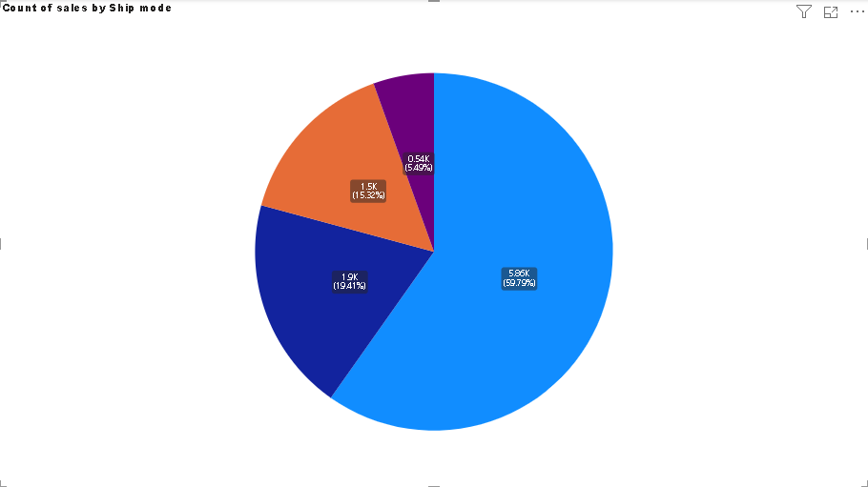
Most Preferred Ship Mode
The pie chart shows the various ship modes per count
From the chat, we can deduce the following;
The standard class currently has the greatest preference in terms of mode of shipping at a total count of 5859 representing 59.79%, followed by second class which also has a total count of 1902 representing 19.41%. followed by first class with a total count of 1501 representing 15.32% and the lowest counting ship mode which is “same day” with a total count of 538 representing 5.49%.

Slide 17
Thank You

